Slide 1
CRI3I3 Pemrograman Perangkat Bergerak
User Interaction

Slide 2
User Interaction
Stateful & Stateless Widget
Button
SnackBar
Dialog
Menu

Slide 3
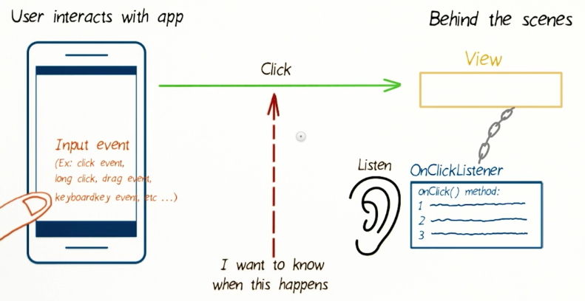
Event Listener
Like Swing, you can set the listener to the Widget

Slide 4
Why Use Event Listener
To change the behavior of your button while your app is running. You can point your button at another method entirely, or just disable the button by setting it into doesn't do anything.
To allows you to control a button's behavior from somewhere other than its dart page

Slide 5
Stateful & Stateless Widget
Stateless Widget: or static widget, means the state of widget (layout and content) can’t change and can’t be changed
Example: Icon, Text
Stateful Widget: or dynamic widget, means the state of widget can change and can be changed
Example: Checkbox, Radio, Slider, InkWell, Form, and TextField

Slide 6
Stateless Widget
Text with
a number 10
class MyApp extends StatelessWidget {
@override
Widget build(BuildContext context) {
return Scaffold(
appBar: AppBar(
title: Text('ExampleApp'),
),
body: Center(
child: Text(
'10',
style: TextStyle(
fontSize: 30
),
),
)
);
}
}

Slide 7
Stateful Widget
See the code when you create new project in Flutter. When we click the “+1” button, the number in the center will increment
class MyApp extends StatelessWidget {
@override
Widget build(BuildContext context) {
return Scaffold(
appBar: AppBar(
title: Text('ExampleApp'),
),
body: Container(
child: NumberScreen(),
)
);
}
}

Slide 8
Stateful Widget
class NumberScreen extends StatefulWidget {
@override
_NumberScreenState createState() =>
_NumberScreenState();
}
class _NumberScreenState extends
State<NumberScreen> {
int number = 10;
@override
Widget build(BuildContext context) {
return Stack(
children: <Widget>[
Center(
child: Text(
this.number.toString(),
style: TextStyle(
fontSize: 30
),
),
),
Positioned(
bottom: 50,
right: 50,
child: FloatingActionButton(
child: Icon(Icons.plus_one),
onPressed: () {
setState(() {
this.number += 1;
});
},
),
)
],
);
}
}

Slide 9
Button
Button is a widget that provides user to trigger an event
There are many types of Button:
FlatButton
RaisedButton or ElevatedButton
OutlineButton
FloatingActionButton
DropdownButton
IconButton
PopupMenuButton

Slide 10
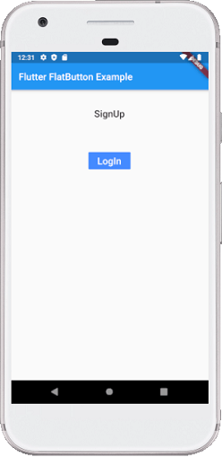
FlatButton
Standard rectangle button with text. Can use color

Slide 11
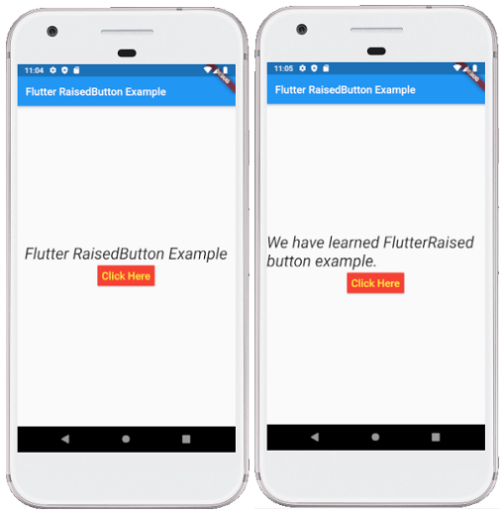
RaisedButton / ElevatedButton
Like FlatButton, but has elevation (Z-axis change) when pressed. It has additional properties like shape, animation time, elevation

Slide 12
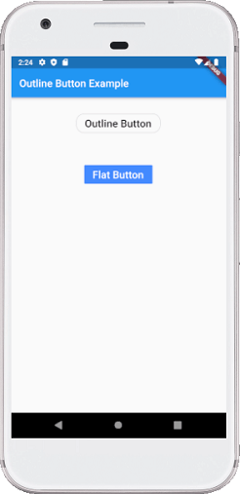
OutlineButton
Like FlatButton, but has a thin grey rounded rectangle border

Slide 13
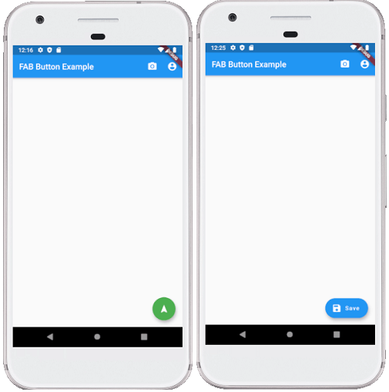
FloatingActionButton
Circular icon button that floated and stacked on top of layout, usually positioned at bottom right corner. Can use image or icon

Slide 14
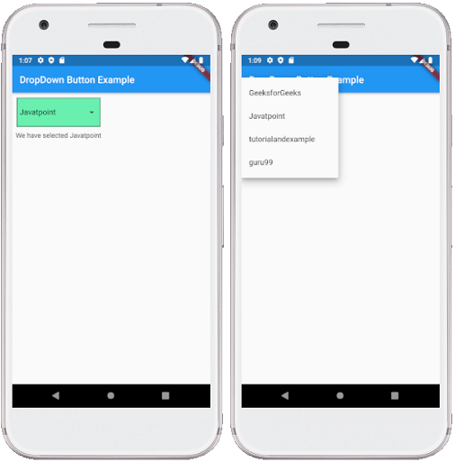
DropDownButton
Button that contains overlay options

Slide 15
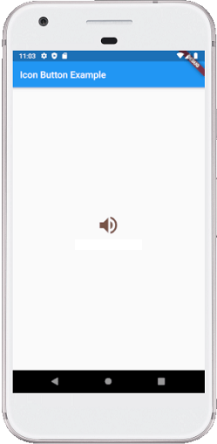
IconButton
Button from Icon or Image

Slide 16
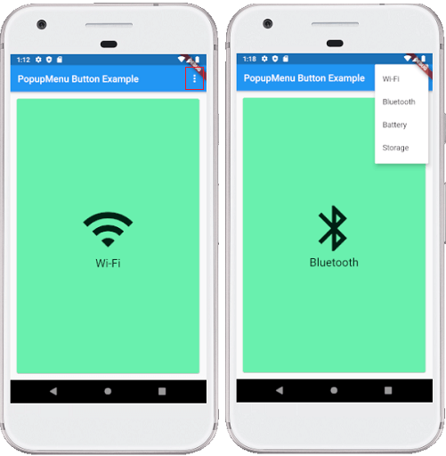
PopupMenuButton
Button that displays menu when pressed. Usually used in AppBar

Slide 17
SnackBar
SnackBar is a floating rectangle widget that contains message and clickable text to do some action:
Scaffold
return MaterialApp(
title: 'SnackBar Demo',
home: Scaffold(
appBar: AppBar(
title: const Text('SnackBar Demo'),
),
body: const SnackBarPage(),
),
);

Slide 18
SnackBar
Show the widget and call the action
const snackBar = SnackBar(
content: Text('Yay! A SnackBar!'),
);
// Find the ScaffoldMessenger in the widget tree
// and use it to show a SnackBar.
ScaffoldMessenger.of(context).showSnackBar(snackBar);
final snackBar = SnackBar(
content: const Text('Yay! A SnackBar!'),
action: SnackBarAction(
label: 'Undo',
onPressed: () {
// Some code to undo the change.
},
),
);

Slide 19
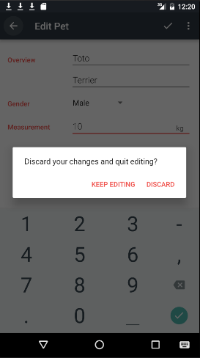
Dialog
A dialog is a small window that prompts the user to make a decision or enter additional information
A dialog does not fill the screen and is normally used for modal events that require users to take an action before they can proceed.

Slide 20
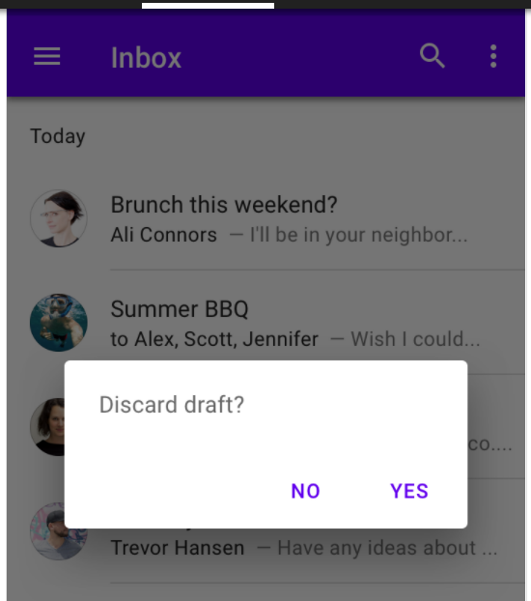
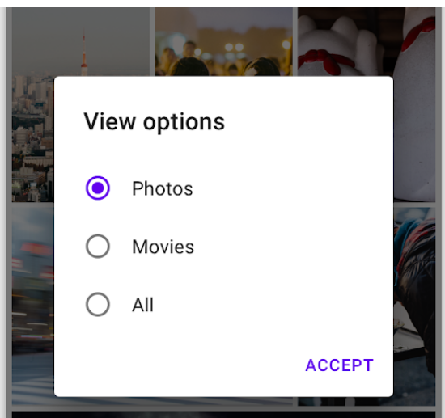
Example: Alert Dialog & Simple Dialog

Slide 21
Alert Dialog
void tampilkanalert() {
AlertDialog alertDialog = new AlertDialog(
content: new Container(
height: 200.0,
child: new Center(
child: new Text("Hello Ini Alert"),
),
),
actions: [
FlatButton(
child: Text('Tutup'),
onPressed: () {
Navigator.of(context).pop();
},
),
],
);
showDialog(context: context, child: alertDialog);
}

Slide 22
Simple Dialog
SimpleDialog simple = SimpleDialog(
title: const Text('Select assignment'),
children: <Widget>[
SimpleDialogOption(
onPressed: () { Navigator.pop(context, Department.treasury); },
child: const Text('Treasury department'),
),
SimpleDialogOption(
onPressed: () { Navigator.pop(context, Department.state); },
child: const Text('State department'),
),
],
);

Slide 23
Menu
TabBar (see previous chapter)
BottomNavigationBar
Usually used for PageView
AppBar

Slide 24
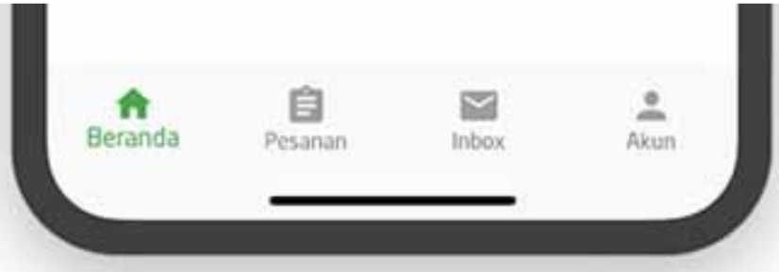
BottomNavigationBar
bottomNavigationBar: BottomNavigationBar(
items: const <BottomNavigationBarItem>[
BottomNavigationBarItem(
icon: Icon(Icons.home),
title: Text('Beranda'),
),
...
],
currentIndex: 0,
selectedItemColor: Colors.green,
unselectedItemColor: Colors.grey,
showUnselectedLabels: true,
),

Slide 25
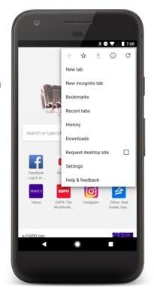
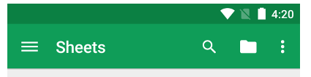
AppBar

Slide 26
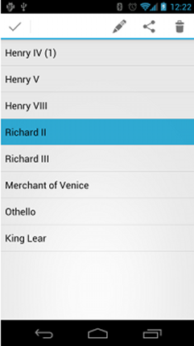
Contextual Menu: Action Mode
Displays action items that affect the selected content in a bar at the top of the screen and allows the user to select multiple items.
Invoke the contextual action mode upon one of two events (or both):
User performs a long-click on the view.
User selects a checkbox or similar UI component within the view.

Slide 27

Any question?

Slide 28
References
https://docs.flutter.dev/development/ui/interactive
https://docs.flutter.dev/development/ui/widgets/material
https://www.javatpoint.com/flutter-buttons

